Slide 1
Building Office Add-ins for Microsoft Excel
Working with Tables and Charts
Notes:
Microsoft Office clients enable developers to create add-ins that extend Microsoft Excel with custom functionality. Through a JavaScript API, developers can manipulate the content in an Excel workbook from an app running in the task pane. In this module, you'll learn how to build an Excel add-in that inserts (and replaces) text ranges, tables, charts, and dialogs.

Slide 2

Working with Tables and Charts
Anatomy of Excel Add-in
Table and headers
Filtering and sorting tables
Charts
Chart options
Demo
Notes:
The Excel JavaScript API makes programmatic control over text, tables, and charts in Excel workbooks. In this unit, you'll learn how to work with tables including formatting options, how to filter data, and sort the data within the table. You'll also learn how to add and customize charts to your worksheets.

Slide 3

Office 365 Platform
EXTENSIONS
Common across canvases
Action
Task pane
Dialog box
Event
DOCUMENTS
PAGES


CONVERSATIONS
CANVASES
Canvas specific
extensions
Data import
Dictionary
Connectors
Actionable emails
Navigation
Branding
Notes:
The Microsoft Office 365 platform offers a number of canvases for developers to embed customizations and Office add-ins are one of three canvases: documents, conversations and pages.
Microsoft Teams makes conversations between users and enables developers to extend the experience using messaging extensions, conversational bots, and other customization options.
Developers customize pages in SharePoint Server and SharePoint online using the SharePoint Framework.
Office clients, such as Word, Excel, PowerPoint, OneNote, and Outlook can also be extended to implement custom task panes, actions, and additional customizations using add-ins.

Slide 4
Anatomy of Office.js Add-in for Microsoft Excel
Initialize Office when Add-in page first loads via Office.initialize
Office.initialize = function (reason) {
if (!Office.context.requirements.isSetSupported(‘ExcelApi', 1.7)) {
console.log(‘Unsupported client’);
}
else {
Excel.run(function (context) {
// Do Excel stuff
context.load(obj, obtions);
return context.sync()
.then(() => {
// Do more Excel stuff
});
})
.catch(function (error) {
console.log("Error: " + JSON.stringify(error));
});
}
Check if client supports API version
Get context to perform operations
Load desired properties
Sync context to execute batch operations
Use promises to get results or perform additional operations
Handle errors
Notes:
We'll start by looking at an anatomy of an Office.js for Microsoft Excel:
- All Office add-ins must call off the `Office.initialize()` method when a page first loads the add-in.
- If you're using a newer Office.js capability in your add-in, it's important to check if the client supports those extensions using the `requirements` API.
- For the Excel JavaScript APIs, you'll use the `Excel.run()` method to get an instance of the current document `context`.
- Once you have a reference to the current Excel document's `context`, you can load any properties on the context using the `load()` method. This method will add the request queue, allowing you to chain multiple requests together for performance reasons.
- When you're ready to retrieve the properties you queued, or to do any queued actions, use the`context.sync()` method to execute the batch of queued operations defined using the `load()` method.
- The `context.sync()` method returns a JavaScript promise that can be used to get results or a previous operation and do new operations.
- As a best practice, you should listen for, catch, and handle any errors that might occur when working with the Excel JavaScript APIs.

Slide 5
Excel object hierarchy
Hierarchy of a workbook
Office.js provides context to an Excel workbook through Excel.run and the context.workbook property.
The workbook contains worksheets, which contains a number of collections, including charts, tables, pivotTables, and more.
Many objects within a worksheet can be accessed directly from the workbook object, including tables and pivotTables.
Worksheets
Worksheets are aware of their siblings using getNext and getPrevious operations.
You can get the active worksheet using workbook.worksheets.getActiveWorkshee() and set the active worksheet using worksheet.activate().
Office.js also offers a number of worksheet events such as onActivated, onDeactivated, onSelectionChanged and more.
workbook
worksheet
table
chart
worksheet
table
chart
Notes:
Excel add-in developers should understand an Excel workbook's's hierarchy and how that relates to the objects in Office.js.
### Hierarchy of a workbook
Office.js provides context to an Excel workbook through Excel.run and the context.workbook property.
The workbook contains worksheets that contain a number of collections. These collections include things such as charts, tables, and pivotTables.
Many objects within a worksheet can be accessed directly from the workbook object, including tables and pivotTables.
### Worksheets
Worksheets are aware of their siblings using `getNext()` and `getPrevious()` methods.
You can get the active worksheet using the `workbook.worksheets.getActiveWorkshee()` method and set the active worksheet using `worksheet.activate()` method.
Office.js also offers a number of worksheet events such as `onActivated`, `onDeactivated`, and `onSelectionChanged` that developers can use in their custom add-ins.

Slide 6
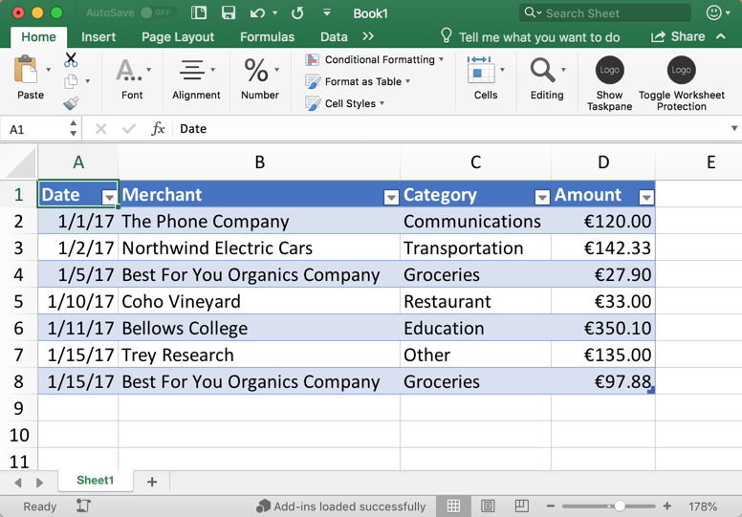
Tables and headers
Ranges
A range represents a set of one or more contiguous cells such as a cell, a row, a column, block of cells, etc.
You can get a range object with Office.js using a worksheet and address (ex: “A1:D4” represents a range from topLeft to bottomRight cells)
Tables
A table is established based on a range of data.
The tables.add function accepts a data range with a flag to indicate if the table has headers or not.
Existing tables can be retrieved by name/id or iterated through.
After the table is added, headers and table rows can be added using 2D arrays.
Headers
A table created with a header flag will use the first row in the data range for its headers.
You can also set header values using the getHeaderRowRange().values property with a 2D array.
Notes:
Tables are at the heart of a spreadsheet. Excel supports defining a range of data that is the foundation of a table of data.
### Ranges
A range represents a set of one or more contiguous cells such as a cell, a row, a column, block of cells, etc.
You can get a range object with Office.js using a worksheet and address. For example, range "A1:D4" represents a range from top left to bottom right cells in this screenshot.
### Tables
A table is established based on a range of data.
The `tables.add()` function accepts a data range with a flag to indicate if the table has headers or not.
Existing tables can be retrieved by their named range or ID. Developers can also iterate through a collection of tables in the worksheet.
After the table is added, headers and table rows can be added using two dimensional arrays.
### Headers
A table created with a header flag will use the first row in the data range for its headers.
You can also set header values using the `getHeaderRowRange().values` property with a two dimensional array.

Slide 7
Tables and headers
// Get range from worksheet
const range = currWorksheet.getRange('A1:D1');
// Insert table into current worksheet
const table = currWorksheet.tables.add(range, true);
table.name = "ExpensesTable";
// Get table by name (can also be performed on worksheet)
const table = workbook.tables.getItem("ExpensesTable");
// Add header row to table
table.getHeaderRowRange().values = [["Date", "Merchant", "Category", "Amount"]];
// Freeze header row where 1 is the count of rows at top to freeze (0 to unfreeze)
currWorksheet.freezePanes.freezeRows(1);
Notes:
Here are some examples of working with ranges, worksheets, and tables
First, we are getting a range based on address in the current worksheet, again, the current worksheet is available through context.workbook.worksheets.getActiveWorksheet()
Next, we are adding a table to the current worksheet based on the range and naming it the ”ExpensesTable”
We can use this name to easily re-reference the table later as seen in the next code sample
Next, we are setting the header row for the table using a 2D array.
You can also freeze the header row using the freezePanes collection on the worksheet and call freezeRow()

Slide 8
Tables and headers (cont.)
// Delete the second row in a table (at row index of 1)
var row = context.workbook.tables.getItem("ExpensesTable").rows.getItemAt(1);
row.delete();
// Update the second row in a table (at row index of 1)
var row = context.workbook.tables.getItem("ExpensesTable").rows.getItemAt(1);
row.values = [["1/15/2017", "Best For You Organics Company", "Groceries", "97.8"]];
// Add row(s) to the end of the table (null or -1 for row index appends to end)
table.rows.add(null, [
["1/1/2017", "The Phone Company", "Communications", "120"]
]);
// Add row(s) to the beginning row of the table (at row index of 0)
table.rows.add(0, [
["1/10/2017", "Coho Vineyard", "Restaurant", "33"]
]);
Notes:
The first sample on this slide deletes the third row of a table. Notice we reference row three by an index of 1 because it is a zero-based index collection
The next sample updates the values of the second row in a table
And finally, we add a few rows to the back and front of a table. The rows.add function takes the row index where to insert…null or -1 means to insert at the end. Anywhere other than the end and all the rows will shift down to accept the new row(s)

Slide 9
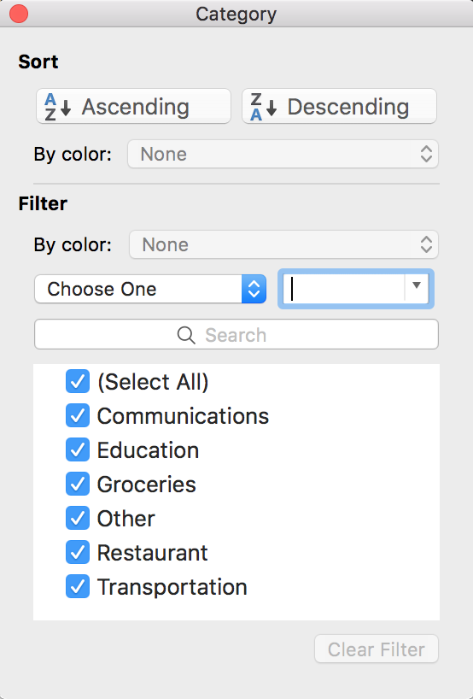
Filtering and sorting tables
Filtering
Any column of a table can be filtered using Office.js.
Filter a column by getting the column and using the applyValuesFilter function on its filter property.
You can also programmatically re-apply filters and clear filters on a table using the table functions reapplyFilters and clearFilters respectively.
Sorting
Table sorting can be applied by passing an array of SortFields to the table.sort.apply() function.
You can re-apply and clear table sorts using table.sort.reapply() and table.sort.clear() respectively.
Notes:
Any column in a table can be filtered using Office.js.
Filter a column by by first getting a reference ot the column and then use the `applyValuesFilter()` method to filter on specific values.
You can also programmatically re-apply filters and clear filters on a table using the table functions `reapplyFilters()` and `clearFilters()` respectively.
## Sorting tables
Developers can sort table data using the Office.js API from Excel add-ins. To sort, call the `table.sort.apply()` method and include the `SortFields` argument to specify the fields to sort on.
You can re-apply and clear table sorts using `table.sort.reapply()` and `table.sort.clear()` methods.

Slide 10
Filtering tables
// Filter table on the "Category" column by values "Education" and "Groceries"
const categoryFilter = table.columns.getItem('Category').filter;
categoryFilter.applyValuesFilter(["Education", "Groceries"]);
// Re-apply filters
table.reapplyFilters();
// Clear filters
table.clearFilters();
Notes:
This slide shows three simple samples for applying a filter, reapplying the filter after edits and clearing filters

Slide 11
Sorting tables
// Sort the table by the second column (at column index of 1) desc then third column asc
const sortFields = [
{ key: 1, ascending: false },
{ key: 2, ascending: true }
];
table.sort.apply(sortFields);
// Re-apply sort
table.sort.reapply();
// Clear filters
table.sort.clear();
Notes:
This slide demonstrates how to sort a table by one or more fields. In this case sorting by the second column descending followed by the third column ascending
You can also see how to reapply a sort after edits are made and how to clear a sort

Slide 12
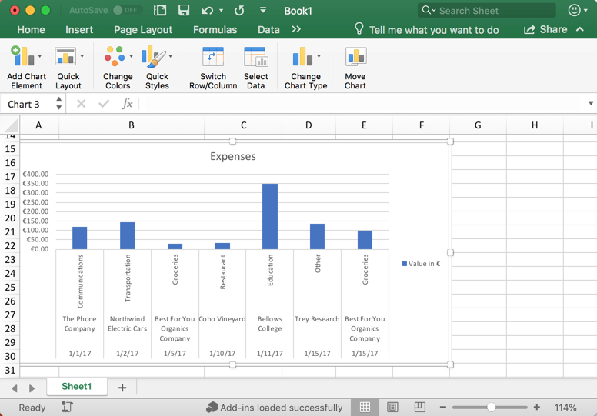
Charts
Charts
Microsoft Excel has become a playground for data manipulation and visualization. So it no surprise that the Excel JavaScript APIs allow developers to add and manipulate charts.
Charts exist within worksheets, but can also be accessed directly from the workbook object.
Charts have a number of complex relational properties that can be used to fine-tune the look of a chart. These include titles, legends, axes, series, labels, format, and much more.
Charts are created based on a data range and are often created in conjunction with tables.
The worksheet.charts.add function is used to create a chart, which accepts a chart type (discussed more in the next slide), a data range, and seriesBy (possible values include Auto, Scalar, Matrix).
Notes:
Microsoft Excel has become a playground for data manipulation and visualization. So it's no surprise that the Excel JavaScript APIs allow developers to add and manipulate charts.
Charts exist within worksheets, but can also be accessed directly from the workbook object.
Charts have a number of complex relational properties that can be used to fine-tune the look of a chart. These include titles, legends, axes, series, labels, and format.
Users and developers can create a chart based on a data range and are often created in conjunction with tables.
The `worksheet.charts.add()` function is used to create a chart, which accepts a chart `type`, a data `range`, and `seriesBy`. The `seriesBy` argument supports the following values
- Auto
- Scalar
- Matrix

Slide 13
Valid chart types
worksheet.charts.add("<CHART_TYPE_BELOW />", range, "auto");
_3DArea
_3DAreaStacked
_3DAreaStacked100
_3DBarClustered
_3DBarStacked
_3DBarStacked100
_3DColumn
_3DColumnClustered
_3DColumnStacked
_3DColumnStacked100
_3DLine
_3DPie
_3DPieExploded
Area
AreaStacked
AreaStacked100
BarClustered
BarOfPie
BarStacked
BarStacked100
Bubble
Bubble3DEffect
ColumnClustered
ColumnStacked
ColumnStacked100
ConeBarClustered
ConeBarStacked
ConeBarStacked100
ConeCol
ConeColClustered
ConeColStacked
ConeColStacked100
CylinderBarClustered
CylinderBarStacked
CylinderBarStacked100
CylinderCol
CylinderColClustered
CylinderColStacked
CylinderColStacked100
Doughnut
DoughnutExploded
Line
LineMarkers
LineMarkersStacked
LineMarkersStacked100
LineStacked
LineStacked100
Pie
PieExploded
PieOfPie
PyramidBarClustered
PyramidBarStacked
PyramidBarStacked100
PyramidCol
PyramidColClustered
PyramidColStacked
PyramidColStacked100
Radar
RadarFilled
RadarMarkers
StockHLC
StockOHLC
StockVHLC
StockVOHLC
Surface
SurfaceTopView
SurfaceTopViewWireframe
SurfaceWireframe
XYScatter
XYScatterLines
XYScatterLinesNoMarkers
XYScatterSmooth
XYScatterSmoothNoMarkers
Notes:
Excel supports many different types of charts. Developers can add a chart to a worksheet using the `worksheet.carts.add("{REPLACE_WITH_CHARTTYPE_ENUM}", range, "{REPLACE_WITH_CHARTSERIESBY_ENUM}")` method.
The `ChartType` argument specifies the type of chart to use. Refer to the SDK for the available options on the [Excel.ChartType enum](https://docs.microsoft.com/javascript/api/excel/excel.charttype).
The `ChartSeriesBy` argument specifies whether the series are by rows or by columns. Refer to the SDK for the available options on the [Excel.ChartSeriesBy enum](https://docs.microsoft.com/javascript/api/excel/excel.chartseriesby).

Slide 14
Chart object properties
Property | Description
chartType | Represents the type of the chart (possible values on previous slide)
height | Represents the height, in points, of the chart object
id | The unique id of chart
left | The distance, in points, from the left side of the chart to the worksheet origin
name | Represents the name of a chart object
showAllFieldButtons | Represents whether to display all field buttons on a PivotChart
top | Represents the distance, in points, from the top edge of the object to the top of row 1 (on a worksheet) or the top of the chart area (on a chart)
width | Represents the width, in points, of the chart object
Notes:
This table outlines the properties of a chart object in Office.js, notice a number of properties to determine the appearance (ex: height, width, top) and many that are used to make the chart easily referenceable such as id and name.

Slide 15
Chart object relationships
Relationship | Type | Description
axes | ChartAxes | Represents chart axes. Read-only.
dataLabels | ChartDataLabels | Represents the datalabels on the chart. Read-only.
format | ChartAreaFormat | Encapsulates the format properties for the chart area. Read-only.
legend | ChartLegend | Represents the legend for the chart. Read-only.
series | ChartSeriesCollection | Represents either a single series or collection of series in the chart. Read-only.
title | ChartTitle | Represents the title of the specified chart, including the text, visibility, position and formatting of the title. Read-only.
worksheet | Worksheet | The worksheet containing the current chart. Read-only.
Notes:
Relationships on the chart object make a big difference in how the chart appears. Here you can manipulate the axes, labels, legend, series, title, and more

Slide 16
Charts
// Insert a clustered column chart using table data
const dataRange = table.getDataBodyRange();
let chart = currWorksheet.charts.add("ColumnClustered", dataRange, "auto");
// Get existing chart by name
let chart = workbook.charts.getItem("MyChart");
// Modify chart properties such as position, titles, colors, sizes, and more
chart.setPosition("A15", "F30");
chart.title.text = "Expenses";
chart.legend.position = "right"
chart.legend.format.fill.setSolidColor("white");
chart.dataLabels.format.font.size = 15;
chart.dataLabels.format.font.color = "black";
chart.series.getItemAt(0).name = "Value in €";
Notes:
This sample shows how to insert a new chart and getting an existing chart based on a name.
The new chart is being defined as a clustered column chart, based on some table data, and asked Excel to figure out if it should be charted rowwise or columnwise
Below you can see how you can use Office.js to manipulate details to perfect a chart

Slide 17
Demo
Notes:
In this demo, we will look at an add-in for Microsoft Excel that manipulates tables and charts in an Excel Workbook
Open the completed solution located in the Demos/04 All Complete folder
Run npm install
Run npm run build
Run npm start
Side-load the add-in
Launch the add-in using the Show Taskpane button in the ribbon
Click the Create Table button to demonstrate table creation
Click the Filter Table button to demonstrate the table being filtered by category
Click the Sort Table button to demonstrate sorting
Click the Create Chart button to create a chart
Click the Freeze Header button to freeze the header row

Slide 18

Summary
Tables and charts are fundamental components of Microsoft Excel and are exposed through Office,js for developers.
Both tables and charts are defined using simple data ranges or 2D arrays.
Office.js exposes a number of properties to fine-tune the look and feel of tables and charts in Excel.

Slide 19
Reading further
Excel Add-ins overview
https://docs.microsoft.com/en-us/office/dev/add-ins/excel/excel-add-ins-overview
Excel JavaScript API reference
https://docs.microsoft.com/en-us/javascript/api/excel?view=excel-js-preview
Excel Add-in samples
https://github.com/OfficeDev?utf8=%E2%9C%93&q=excel
Table and Chart objects
https://docs.microsoft.com/en-us/javascript/api/excel/excel.table
https://docs.microsoft.com/en-us/javascript/api/excel/excel.chart

Slide 20
Thank you

